Slide 1


Digital Portfolio
STUDENT NAME:E.DINESH KUMAR
REGISTER NO AND NMID: 212400934/ 38E0F85D4B45C2AB65643A4E81D46564
DEPARTMENT: BCA
COLLEGE: PRINCE SHRI VENKATESWARA ART’S AND SCIENCE COLLEGE/ MADRASUNIVERSITY
1

Slide 2

Portfolio of your
My portfolio
2

Slide 3



AGENDA
1.Problem Statement 2.Project Overview 3.End Users 4.Tools and Technologies 5.Portfolio design and Layout 6.Features and Functionality 7.Results and Screenshots 8. Conclusion 9.Github Link
3/21/2024 Annual Review
3

Slide 4


PROBLEM STATEMENT
This portfolio website is designed to:Present my skills, experience, and projects in an organized way. Provide a single platform where my work can be accessed anytime, anywhere.
1.
2.
3.Demonstrate my web development/design abilities through
the portfolio itself. For students → Focus on learning, showcasing academic projects. For professionals → Emphasize career growth, job opportunities. For freelancers → Stress on attracting clients and collaborations.
4.
5.
6.
4

Slide 5

PROJECT OVERVIEW
About Me – A summary of my background and interests. Skills – A list of technical and soft skills I possess. – Highlights of my academic and personal projects. Resume – Easy access to my CV for recruiters.
5

Slide 6

WHO ARE THE END USERS?
1.Recruiters & Hiring Managers – To evaluate your skills, projects, and
suitability for a job.
2.2. Clients (for freelancers) – To check your past work and decide
whether to hire you.
3.3. Teachers / Evaluators – If it’s an academic project, they review it
for grading.
4.4. Peers & Collaborators – Students, colleagues, or developers who
may want to collaborate.
5.5. General Audience – Anyone interested in knowing more about your
work, achievements, and skills.
6

Slide 7
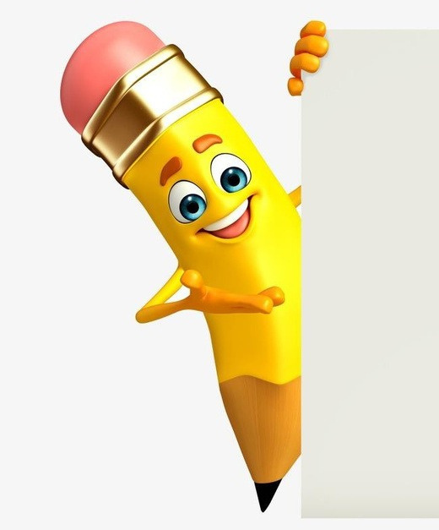
TOOLS AND TECHNIQUES
sticky header with name + navigationA hero section (intro)A thunder/lightning background animationA footer with auto year update
HTML5 – For structuring the web pages.
CSS3 – For styling and layout design.JavaScript – To add
interactivity and dynamic features.
Design (Media Queries/Flexbox/Grid) – To ensure mobile-
friendly viewing.
Code Editor (VS Code / Sublime / Notepad++) – For writing
and editing code.
Web Browser (Chrome / Edge / Firefox) – For testing and
previewing the site.
Git & GitHub (optional) – For version control and hosting.
7

Slide 8

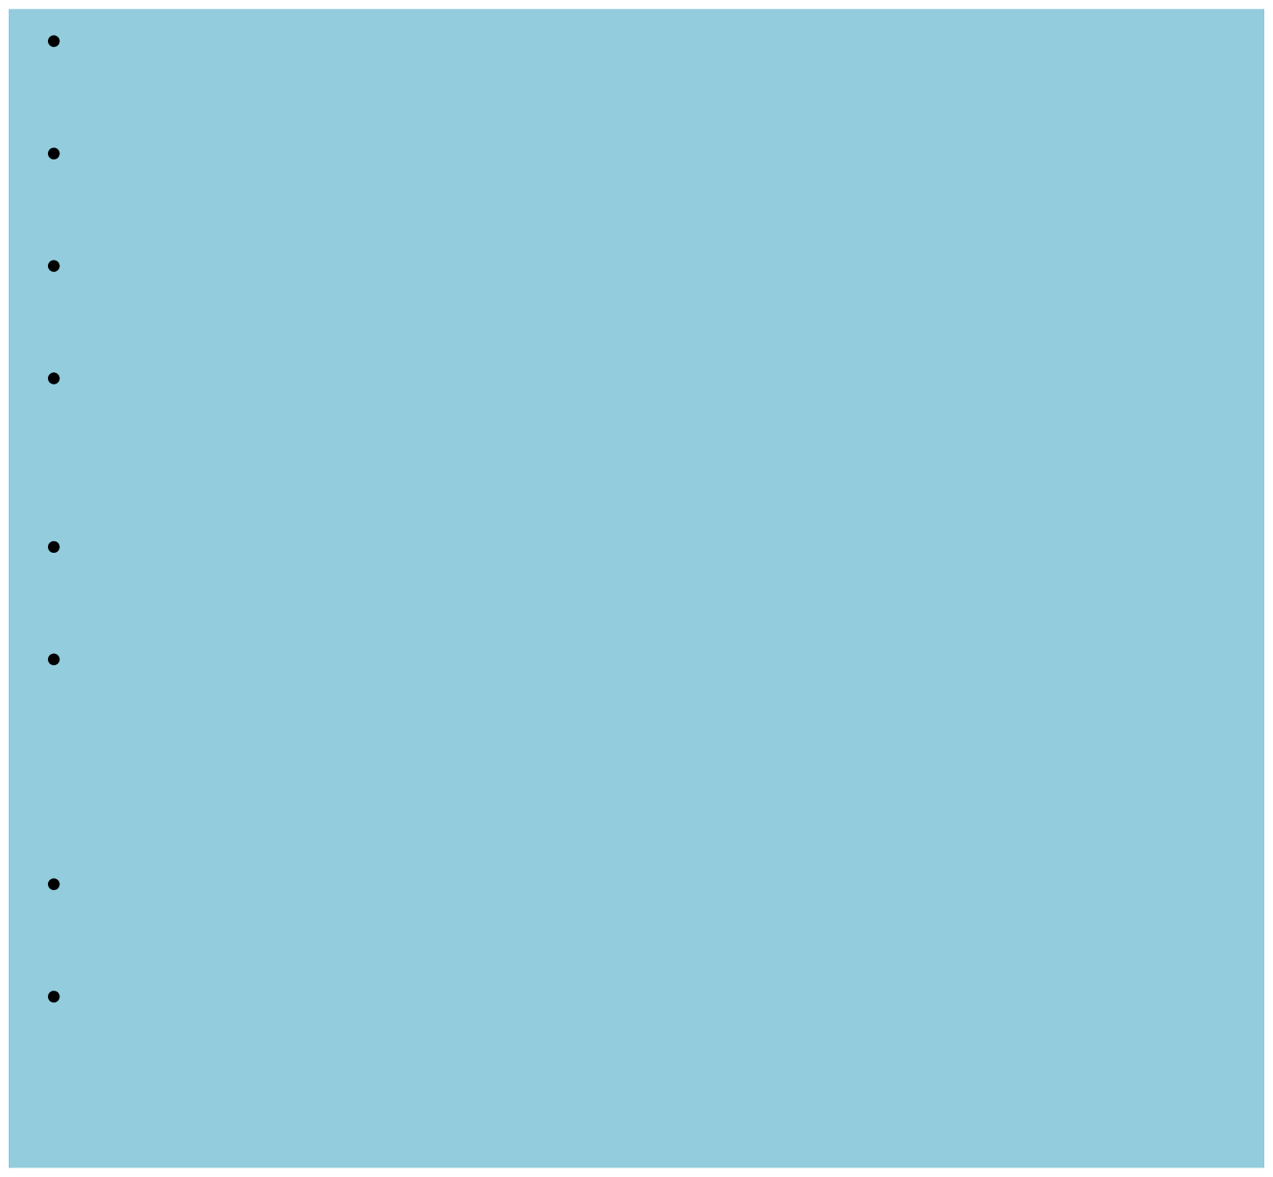

POTFOLIO DESIGN AND LAYOUT
BackgroundBlackbackgroundWhitetextLightning flasheffect
runsin thebackground--- Header (Navbar)Sticky at the top (always visible when scrolling)Semi-transparent black background. (rgba(0,0,0,0.7))Left side → Title “M. Akash” in cyan (#00e5ff) side → Navigation linksCertification (opens IBM certificate in new tab)Contact (opens email app)Hover effect → Links turn cyanHero / Main SectionCenter-aligned : “Welcome” in cyan (#00e5ff), large fontParagraph below → Introduction about youMentions BCA : Prince Shri Venkateswara Arts and Science CollegeSchool: Sri Sankara Vidyalaya Matric Higher Secondary SchoolFooterSemi-transparent black background (rgba(0,0,0,0.8))Centered small white textShows copyright Example: © 2025 M. Akash | PortfolioYear updates automatically with JavaScript--- Special EffectFull-screen thunder/flash effect in the backgroundFlashes white for a split second to mimic lightning
8

Slide 9
FEATURES AND FUNCTIONALITY
DarkTheme → Black background with whitetext fora modern look. Accent Color → Cyan (#00e5ff) used for headings and
highlights. Sticky Navbar → Header stays at the top when scrolling. Navigation Links → Certification link (opens your IBM certificate). Contact link (opens email app). Hero Section → Displays your welcome message and education details. Footer Section → Copyright with auto-updating year. Responsive Layout → Works across desktop and mobile (due to viewport meta tag).
Thunder/Lightning Effect → Animated flash simulates
lightning in the background.

Slide 10
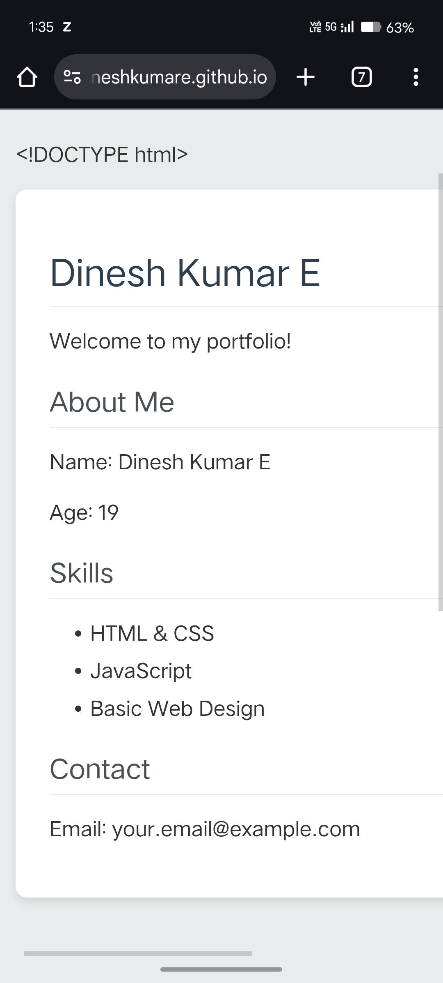

RESULTS AND SCREENSHOTS
3/21/2024 Annual Review
10

Slide 11
GITHUB LINK
https://edineshkumare.github.io/dinesh-portfolio/

Slide 12
CONCLUSION
Thisportfolio webpage is a simple, stylish, and functional
personal site designed with a dark theme and thunder- lightning effect to give a unique visual appeal. It has a sticky navigation bar with links for certification and contact, a hero section that introduces you, and a footer with an auto-updating year.
combination of clean layout, responsive design, interactive
hover effects, and background animation makes it both professional and visually engaging while staying minimal and easy to navigate.
11

